Slide 1
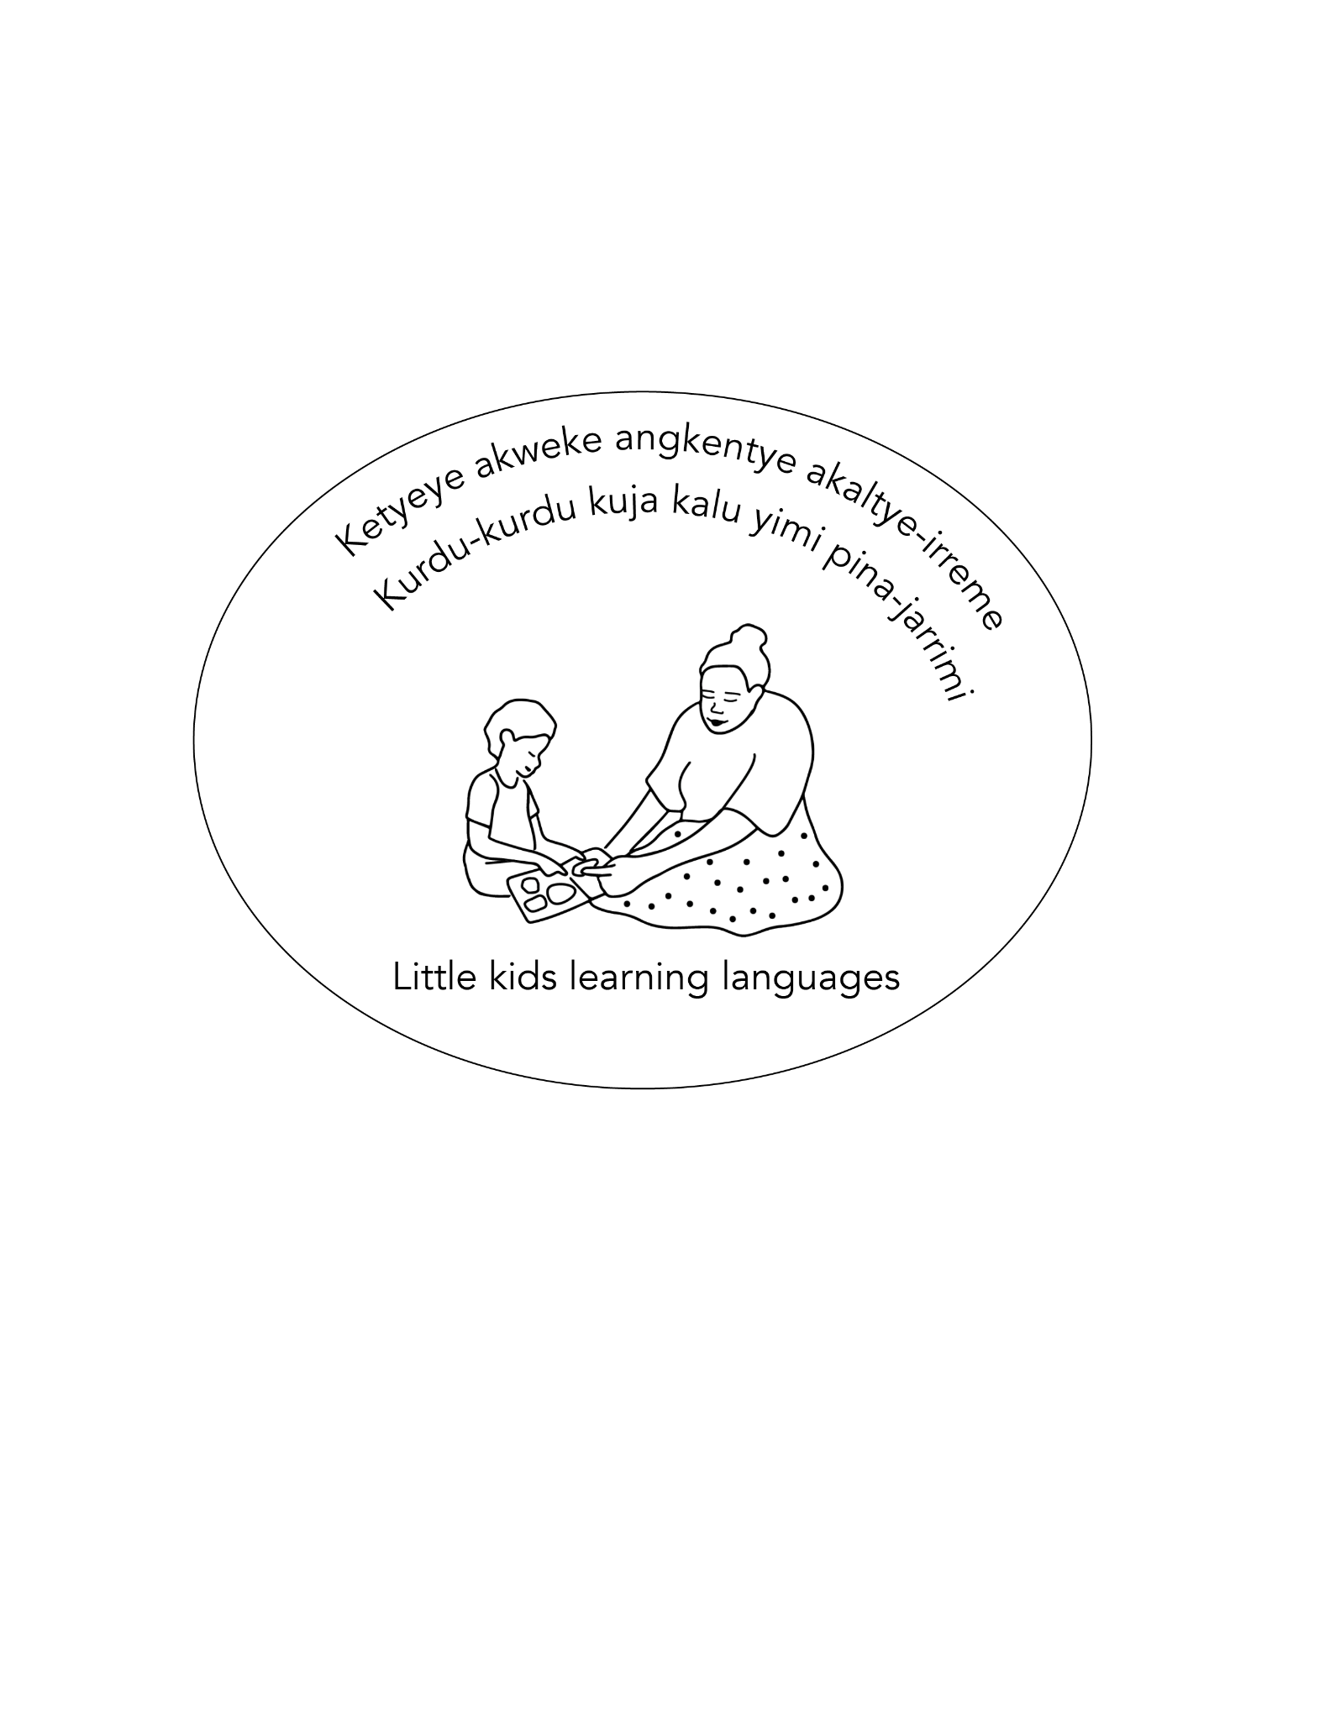
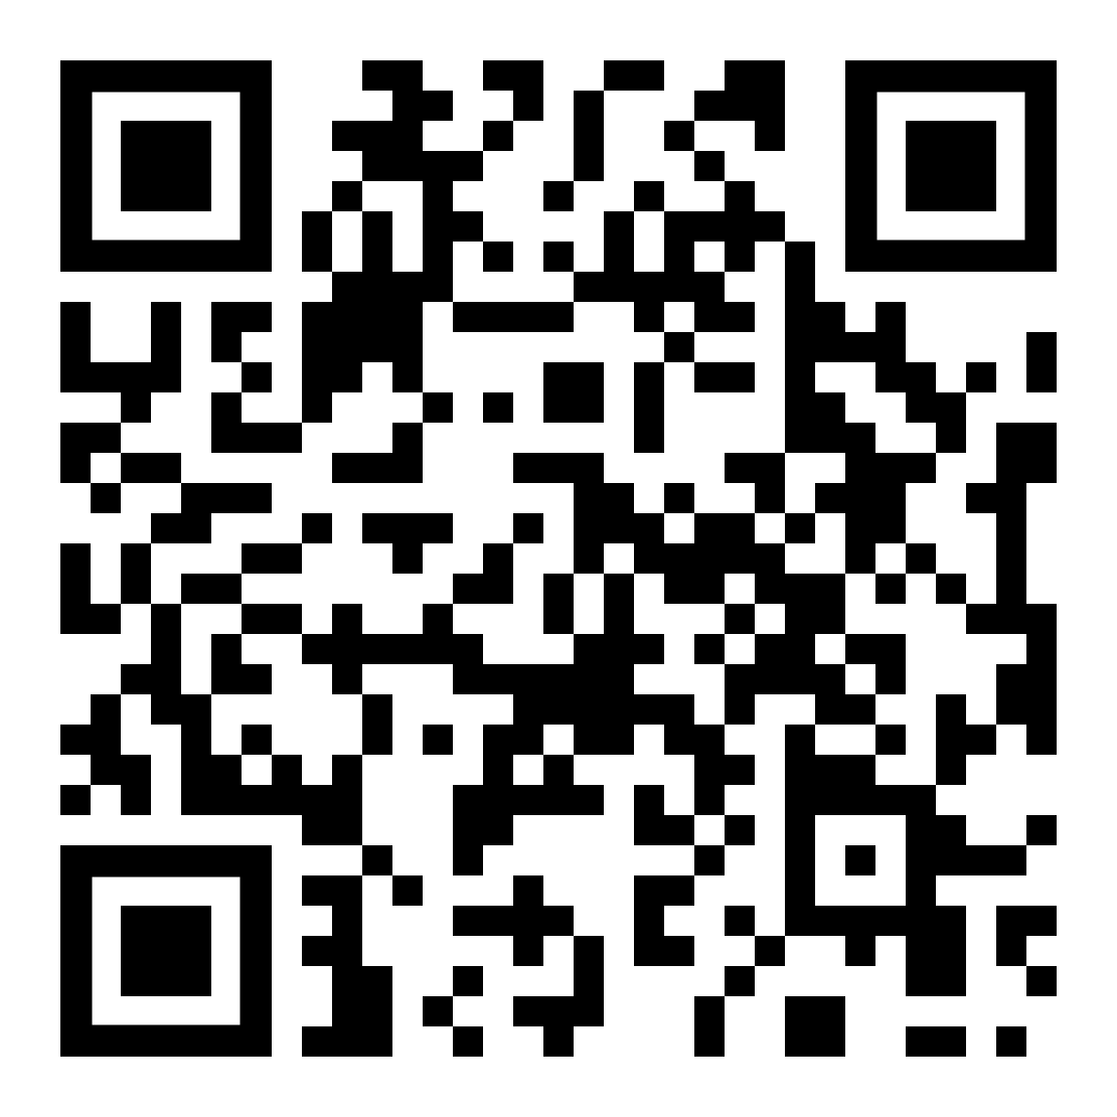
Warlpiri consonant phonemes list
Warlpiri consonant phonemes are presented in the order that young children produce them at 75% accuracy.
1 sound (phone) per page
Project website:
https://little-kids-learning-languages.net/
This information is from work-in-progress, not yet completed or published.
For information about Warlpiri go to: Laughren, Mary, Kenneth Hale, Jeannie Egan Nungarrayi, Marlurrku Paddy Patrick Jangala, Robert Hoogenraad, David Nash, and Jane Simpson. Warlpiri encyclopaedic dictionary. (2022). Aboriginal Studies Press.
https://shop.aiatsis.gov.au/products/warlpiri-encyclopaedic-dictionary
Images and sound recordings are from the Little Kids Learning Languages project; and images are also from
Inge Kral, Samantha Disbray and Jennifer Green (Compilers), 2022. Arlkeny map-akert / Australian Indigenous Languages Image Bank ‘AILIB’. Collection AILIB at catalog.paradisec.org.au [Open Access]. https://dx.doi.org/10.26278/GY4E-MH93

Slide 2

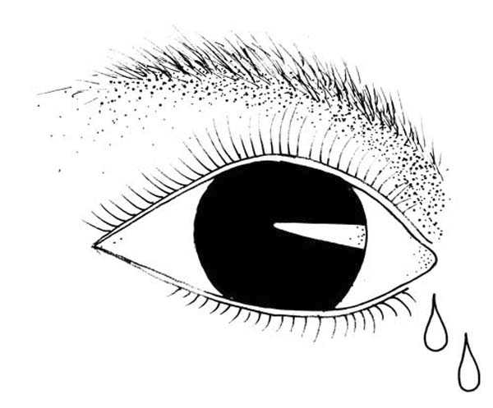
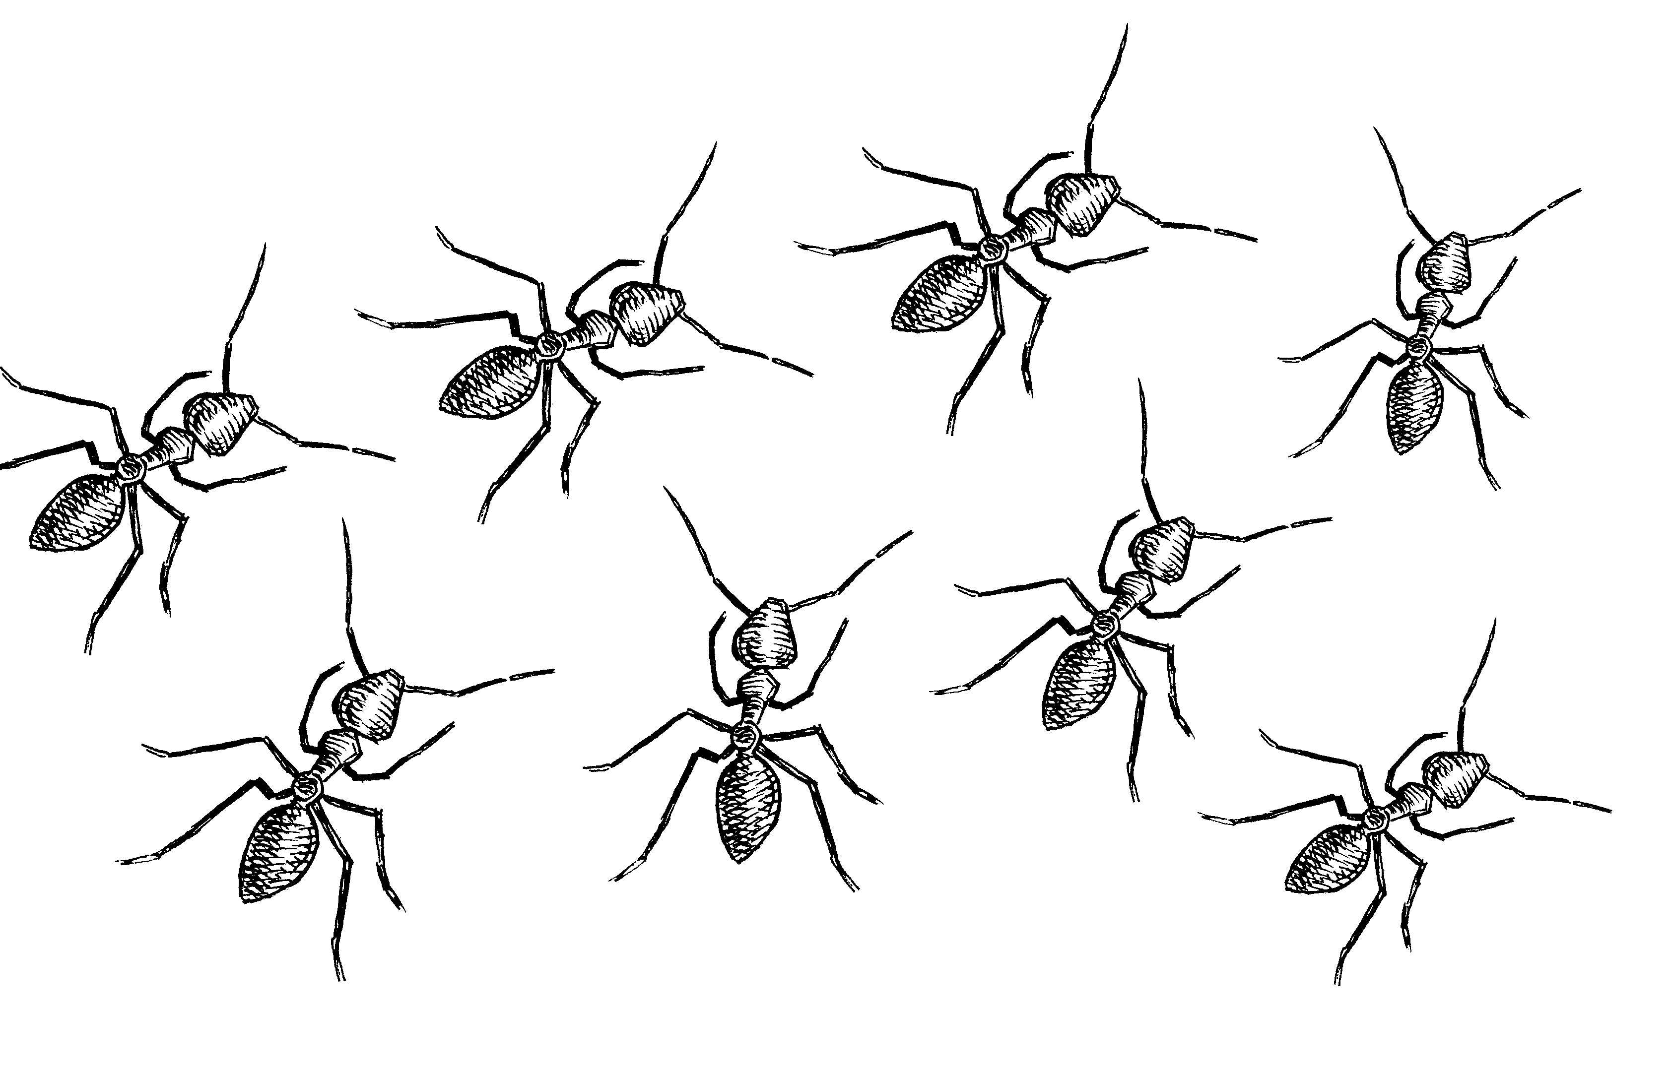
nama / 'nama/
'ant'
Word-initial
Word-medial
milpa / 'milpa/
'eye'
/m/
Acquired at 90% accuracy by age 24 months
Image: Samantha Disbray (collector), Jennifer Green (illustrator), Samantha Disbray (depositor), 2022. JPEG. AILIB-BODY_016-00.jpg at catalog.paradisec.org.au. https://dx.doi.org/10.26278/KNV7-B751
Image: Samantha Disbray (collector), Christine Bruderlin (illustrator), Samantha Disbray (depositor), 2022. INSECT: ants. JPEG/TIFF. AILIB-INSECT_029 at catalog.paradisec.org.au. https://dx.doi.org/10.26278/GH82-5098

Slide 3
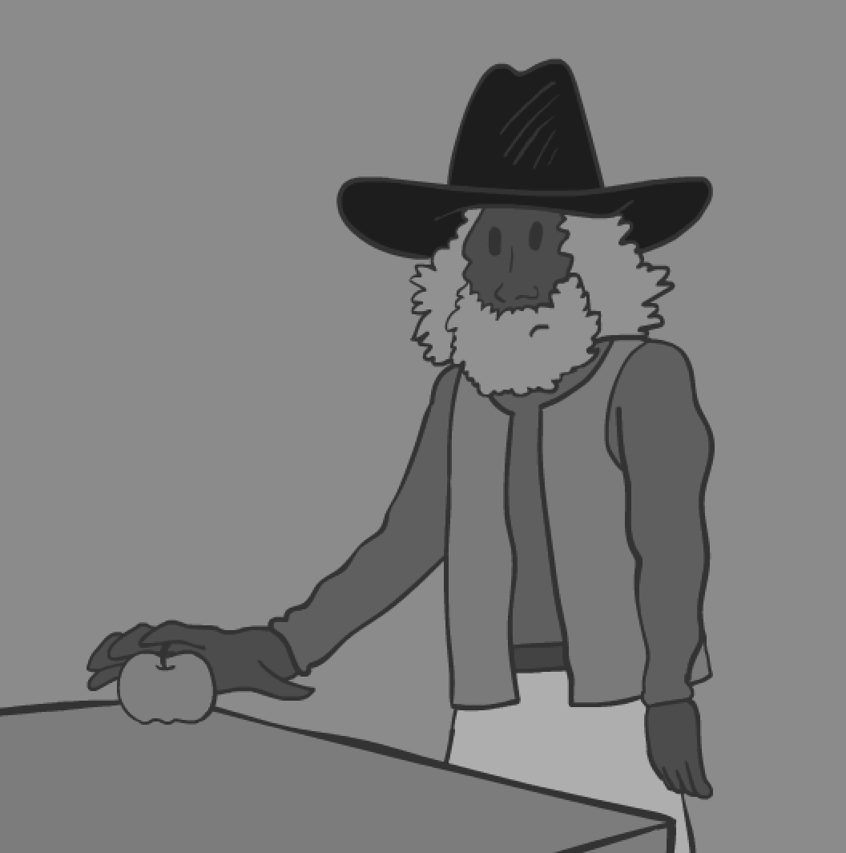
mani /'mani/
'get'
Word-initial
Word-medial
This phoneme doesn’t occur at the beginning of words.
/n/
Acquired at 90% accuracy by age 24 months

Slide 4
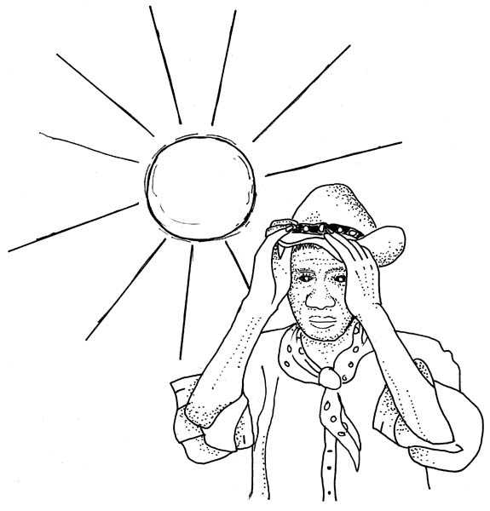
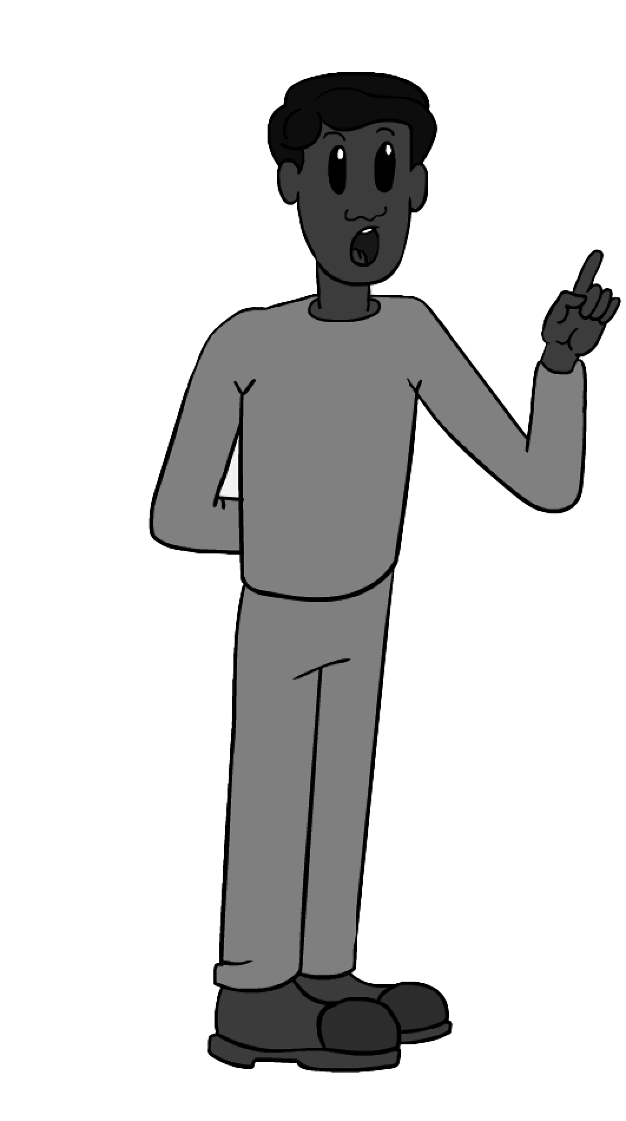
lawa /'lawa/
'no'
Word-initial
Word-medial
wanta /'wanta/
sun
/w/
Acquired at 75% accuracy by age 24 months;
90% by 36-48 months
Image: Samantha Disbray (collector), Christine Bruderlin (illustrator), Samantha Disbray (depositor), 2022. JPEG. AILIB-NATURE_047-00.jpg at catalog.paradisec.org.au. https://dx.doi.org/10.26278/S00X-H708

Slide 5
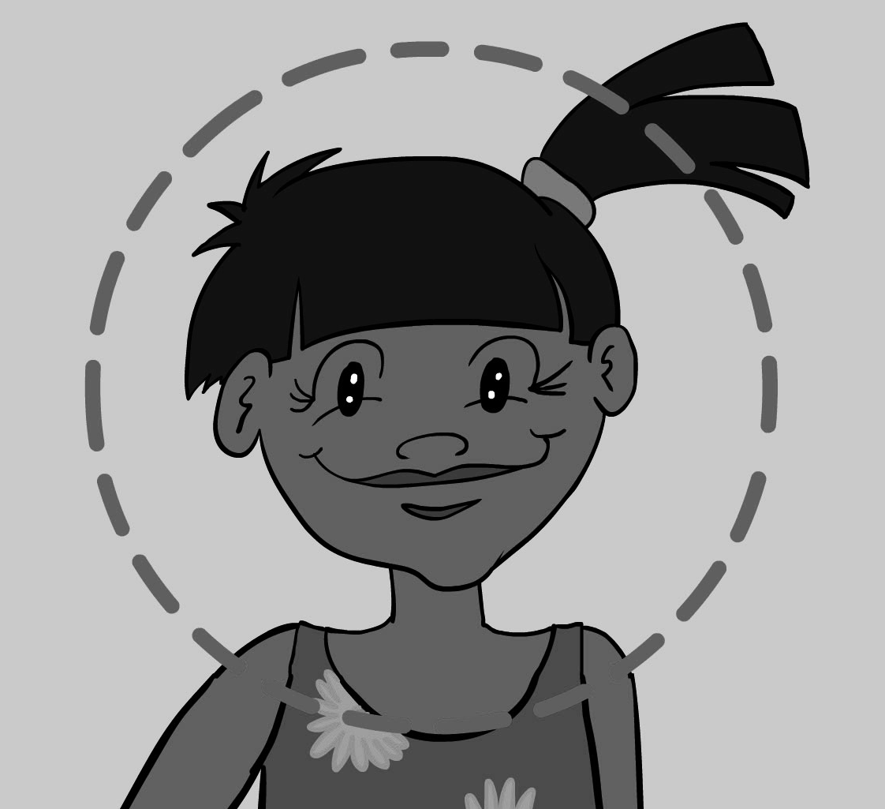

Word-initial
Word-medial
kata /'kata/
'head'
rdaka /'ɽaka/
'hand'
/k/
Acquired at 75% accuracy by age 24 months
Note: There is no voicing distinction in stop phonemes in Warlpiri, i.e. no distinction in Warlpiri between the sounds represented by the letters ‘k’ and ‘g’ in English. The sound is between the English sounds written with ‘k’ and ‘g’. Warlpiri ‘k’ might sound more like an English ‘g’ to English-only speakers in some words.

Slide 6
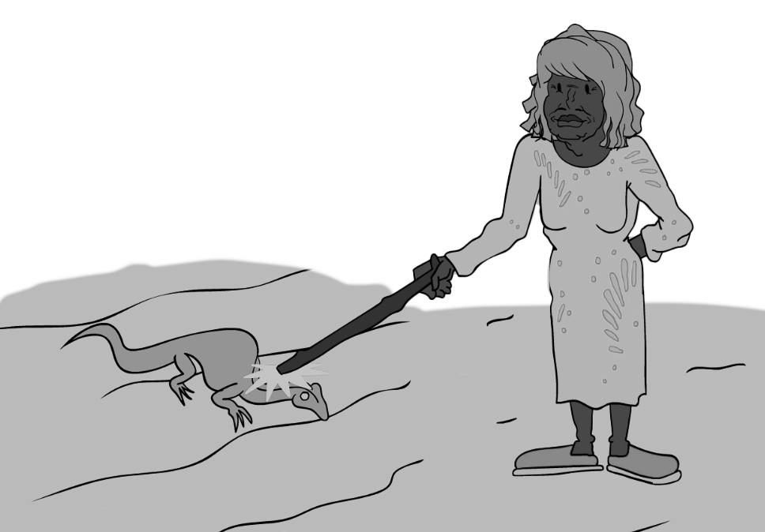
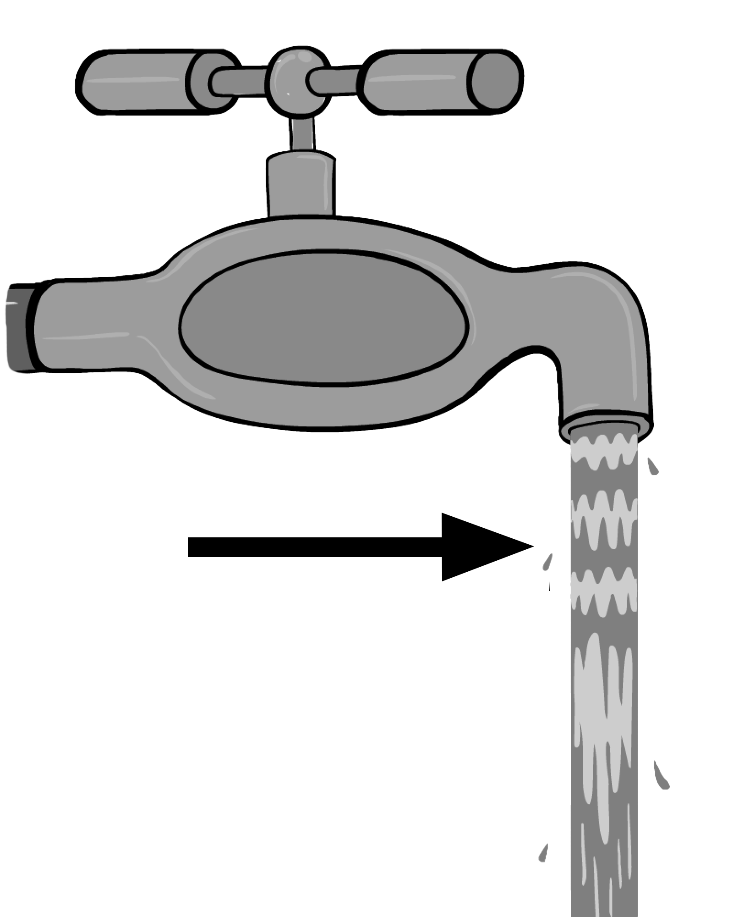
ngapa /'ŋapa/
'water'
Word-initial
Word-medial
pakarni /'pakaɳi/
'hit'
/p/
Just under 75% accuracy at 24 months;
Acquired at 90% accuracy by age 24-36 months
Note: There is no voicing distinction in stop phonemes in Warlpiri, i.e. no distinction in Warlpiri between the sounds represented by the letters ‘p’ and ‘b’ in English. The sound is between the English sounds written with ‘p’ and ‘b’. Warlpiri ‘p’ might sound more like an English ‘b’ to English-only speakers in some words.

Slide 7
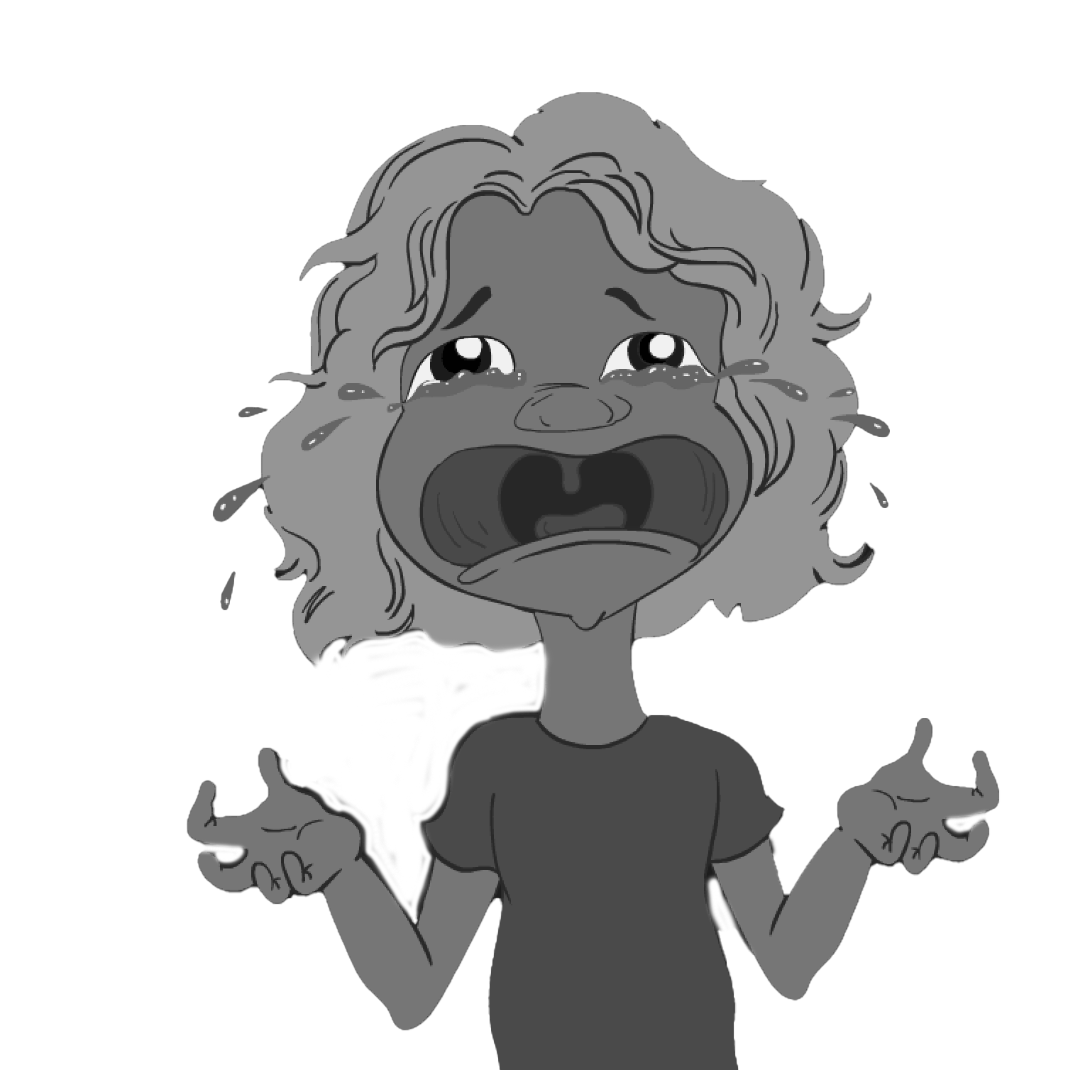
yulami /'julami/
'cry'
Word-initial
Word-medial
This phoneme doesn’t occur at the beginning of words.
/l/
Just under 75% accuracy at 24 months;
Acquired at 90% accuracy by age 24-36 months
Note: At the beginning of words, there is no distinction between /l/ and /ɭ/, and the letter ‘l’ is used in spelling.

Slide 8
kata /'kata/
'head'
Word-initial
Word-medial
This phoneme doesn’t occur at the beginning of words.
/t/
Acquired at 75-90% accuracy by age 24-36 months
Note: There is no voicing distinction in stop phonemes in Warlpiri, i.e. no distinction in Warlpiri between the sounds represented by the letters ‘t’ and ‘d’ in English. The sound is between the English sounds written with ‘t’ and ‘d’. Warlpiri ‘t’ might sound more like an English ‘d’ to English-only speakers in some words.

Slide 9
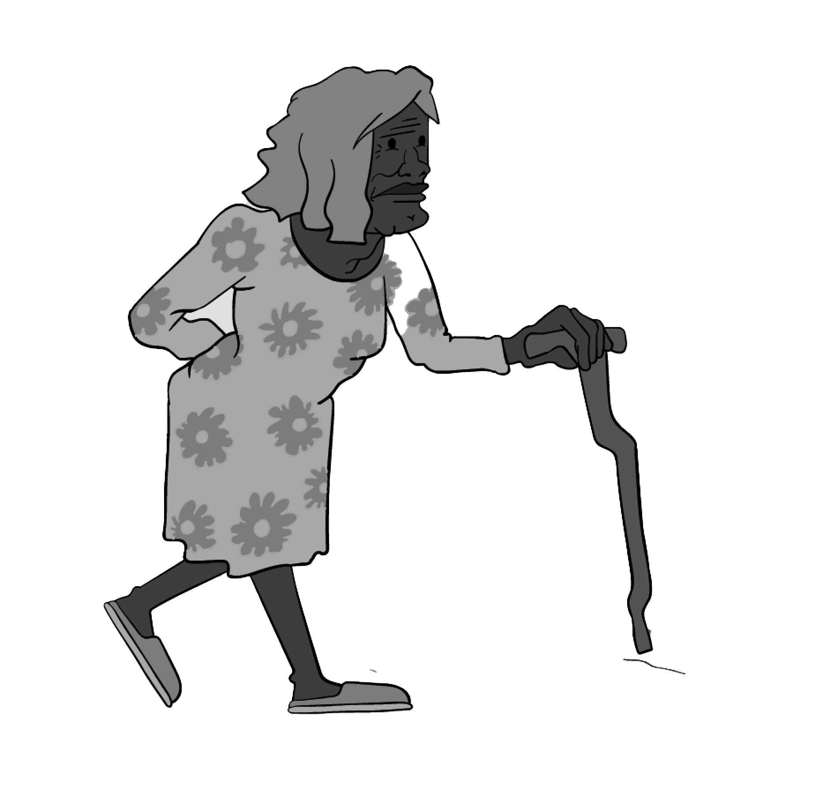
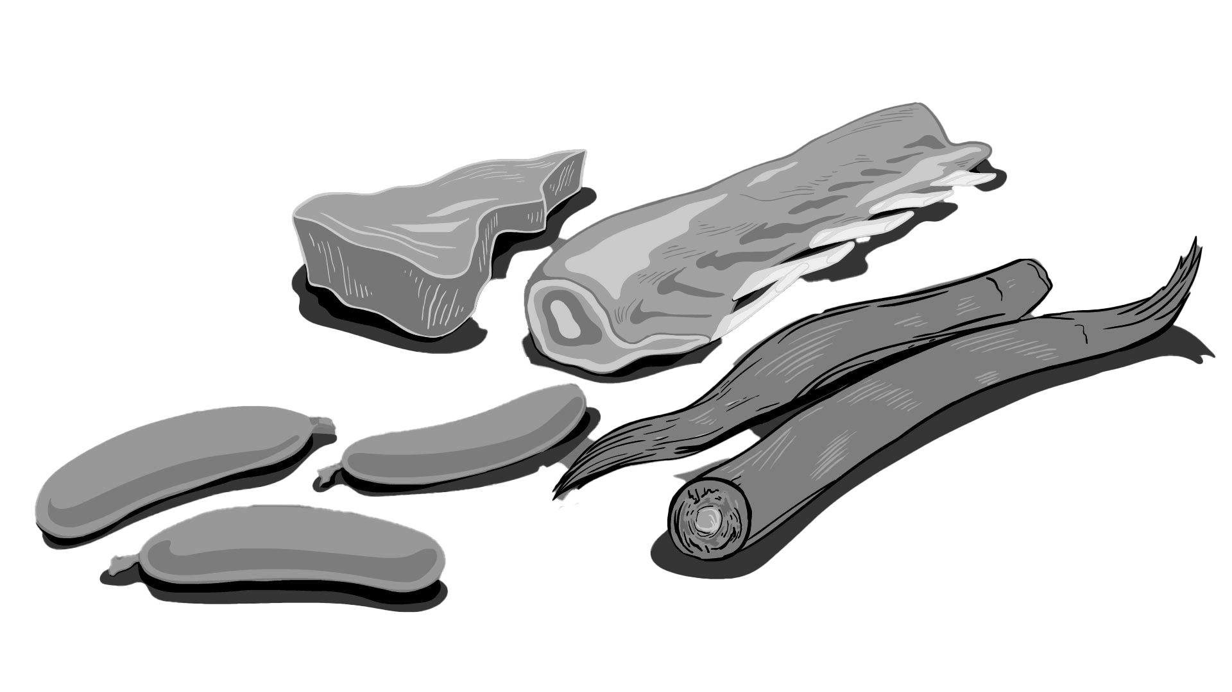
kuyu /'kuju/
'meat'
Word-initial
Word-medial
yani /'jani/
'go'
/j/
Acquired at 75% accuracy by age 24-36 months
90% by 36-48 months

Slide 10
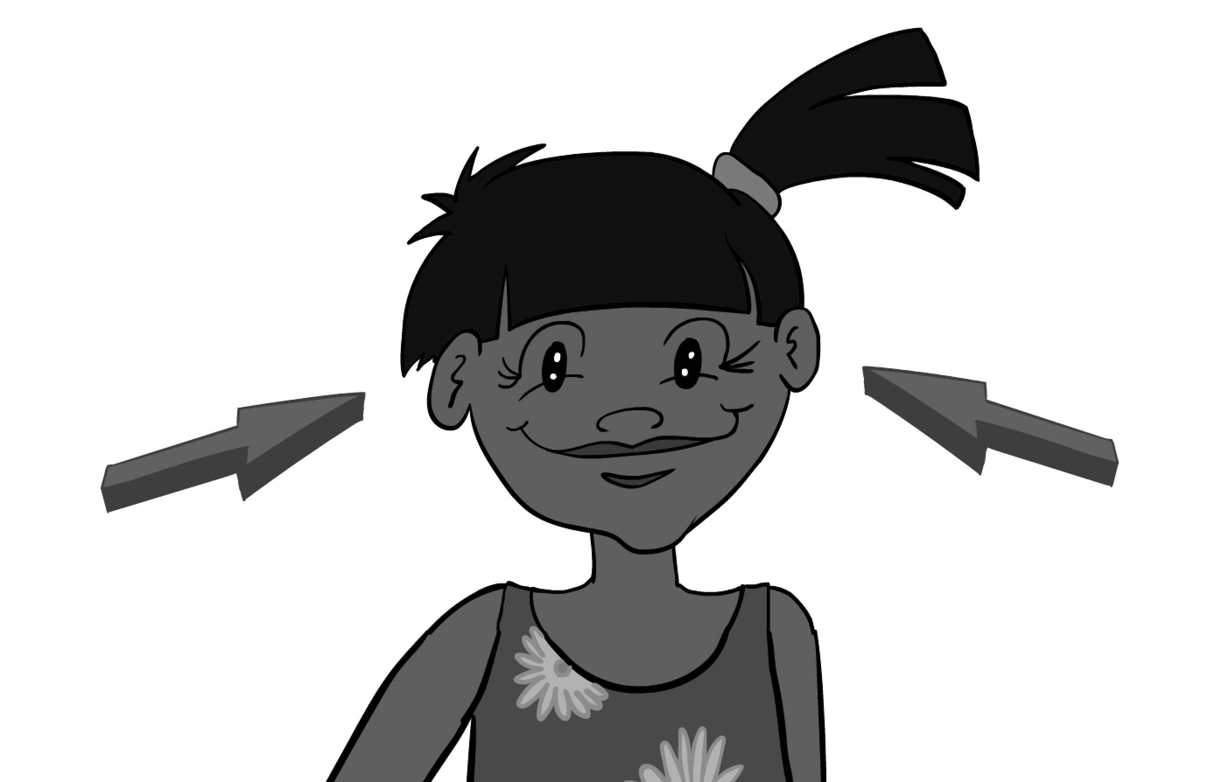
langa /'laŋa/
'ear'
Word-initial
Word-medial
ngapa /'ŋapa/
'water'
/ŋ/
Acquired at nearly 90% accuracy by age 36-48 months

Slide 11
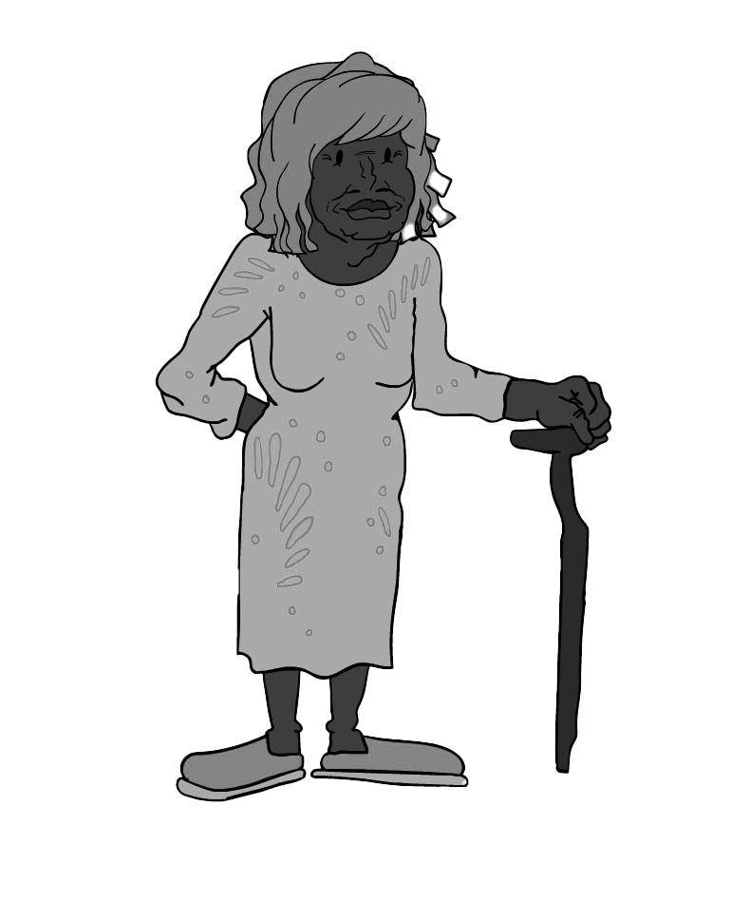
jaja /'caca/
‘father’s mother'
Word-initial
Word-medial
jaja /'caca/
‘father’s mother'
/c/
Acquired at 90% accuracy by age 48-60 months

Slide 12
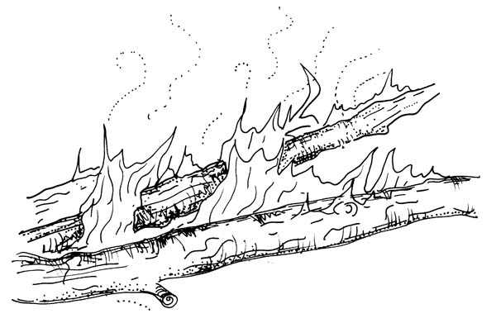
warlu /'waɭu/
'fire'
Word-initial
Word-medial
lawa /'ɭawa/
'no'
/ɭ/
Acquired at 75% accuracy by age 36 - 60 months
Image: Samantha Disbray (collector), unknown unknown (illustrator), Samantha Disbray (depositor), 2022. JPEG. AILIB-NATURE_049-00.jpg at catalog.paradisec.org.au. https://dx.doi.org/10.26278/6QXC-8223
Note: The phoneme /ɭ/ is written ‘rl’, except word-initially, when it is written ‘l’.

Slide 13
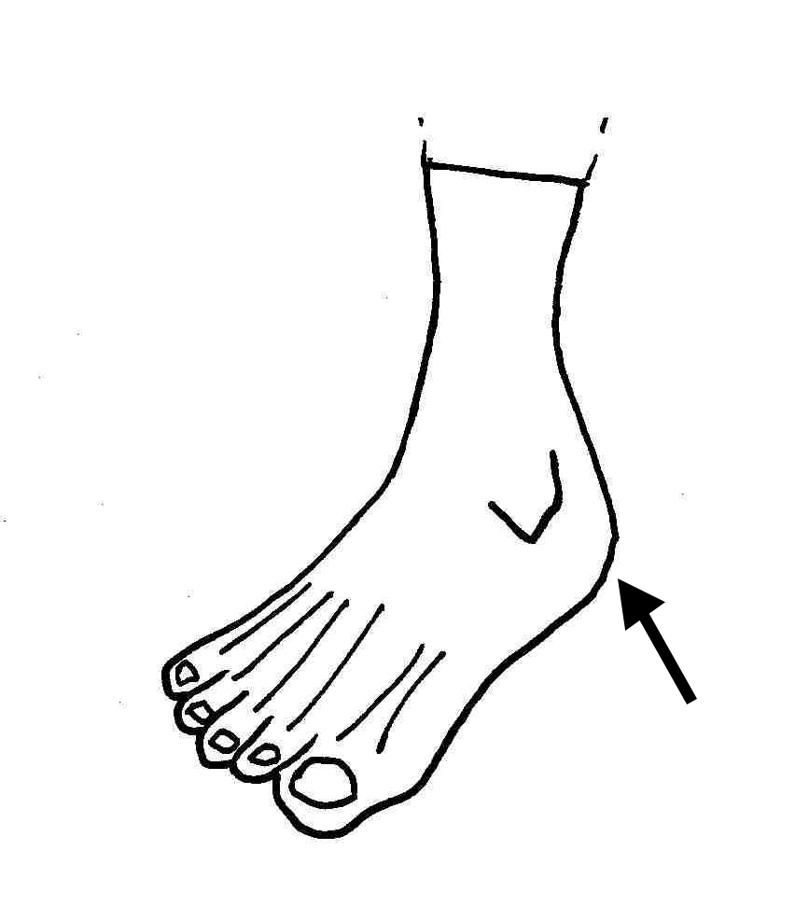
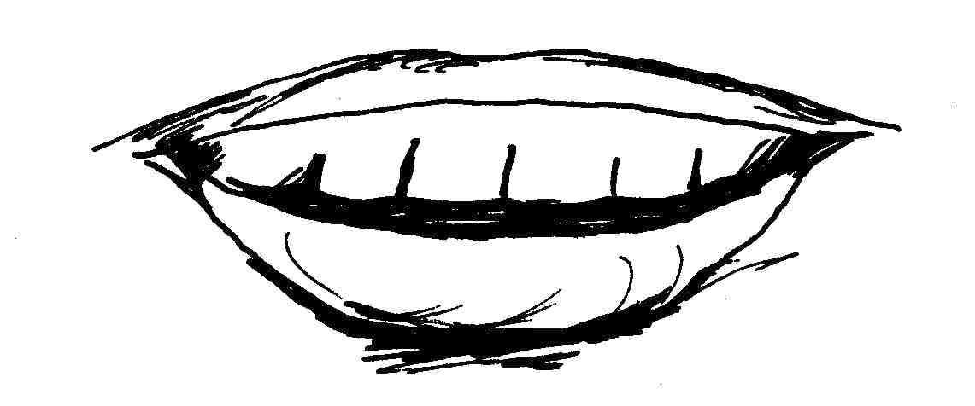
kartirdi /'kaʈiɽi/
'tooth'
Word-initial
Word-medial
tari /'ʈaɻi/
'heel'
/ʈ/
Just under 75% accuracy at 24 – 36 months; later less accuracy
(not many examples in our study)
Image adapted from: Samantha Disbray (collector), David Le May (illustrator), Samantha Disbray (depositor), 2022. JPEG. AILIB-BODY_037-00.jpg at catalog.paradisec.org.au. https://dx.doi.org/10.26278/QFGZ-AC50
Image: Samantha Disbray (collector), David Le May (illustrator), Samantha Disbray (depositor), 2022. JPEG. AILIB-BODY_030-00.jpg at catalog.paradisec.org.au. https://dx.doi.org/10.26278/JZZC-MM17
Note: The phoneme /ʈ/ is written ‘rt’, except word-initially, when it is written ‘t’.

Slide 14
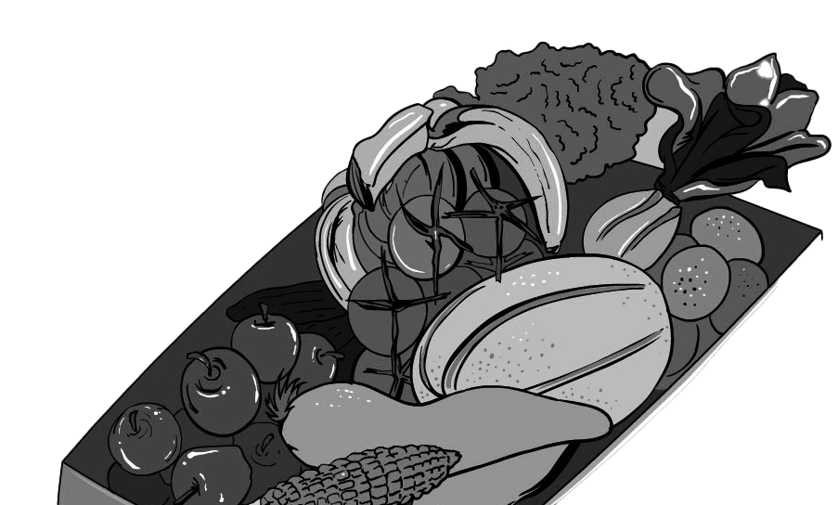
nyanya /'ɲaɲa/
'food'
Word-initial
Word-medial
nyanya /'ɲaɲa/
'food'
/ɲ/
Just under 75% accuracy at 48 – 60 months;
Just under 90% at 60 – 72 months

Slide 15
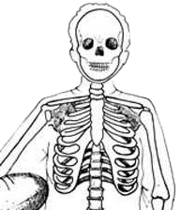
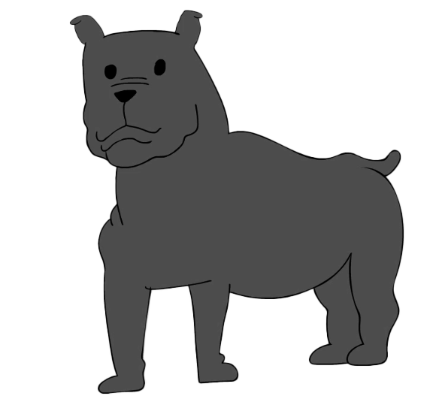
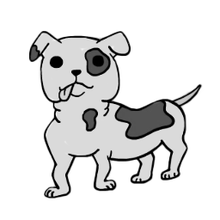
wiri /'wiɻi/
'big'
Word-initial
Word-medial
ramarra /'ɻamara/
'ribs'
/ɻ/
Acquired at 90% accuracy by age 60-72 months
Image adapted from: Samantha Disbray (collector), Jennifer Green (illustrator), Samantha Disbray (depositor), 2022. JPEG. AILIB-BODY_018-00.jpg at catalog.paradisec.org.au. https://dx.doi.org/10.26278/B8E9-K210

Slide 16
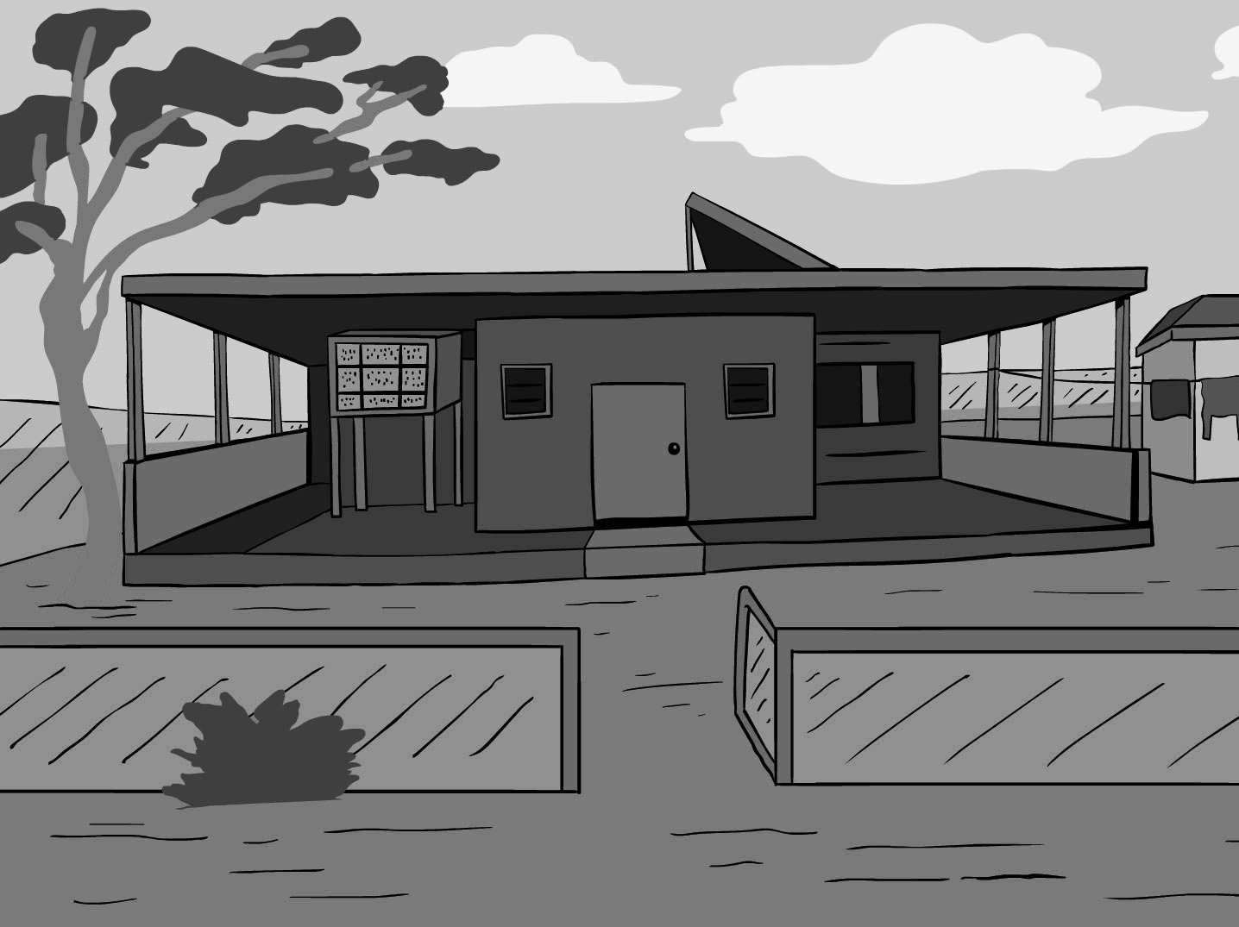
ngurra /'ŋura/
'home'
Word-initial
Word-medial
This phoneme doesn’t occur at the beginning of words.
/r/
Acquired at 75% accuracy by age 60-72 months

Slide 17
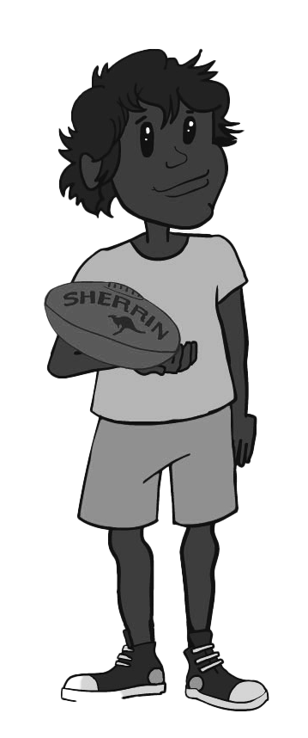
kurdu /'kuɽu/
'child'
Word-initial
Word-medial
rdaka /'ɽaka/
'hand'
/ɽ/
another way to pronounce it
Acquired at 75% accuracy between 48 – 72 months
Note: This phoneme has different realisations at the beginning of words in varieties of Warlpiri, and in some varieties does not contrast with the retroflex stop /ʈ/.
E.g. Laughren, Mary. "Warlpiri baby talk." Australian Journal of Linguistics 4, no. 1 (1984): 73-88. https://doi.org/10.1080/07268608408599321
Bundgaard-Nielsen, Rikke L., and Carmel O’Shannessy. "Voice onset time and constriction duration in Warlpiri stops (Australia)." Phonetica 78, no. 2 (2021): 113-140. https://doi.org/10.1515/phon-2021-2001

Slide 18
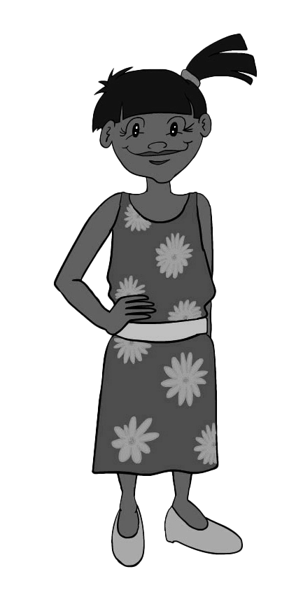
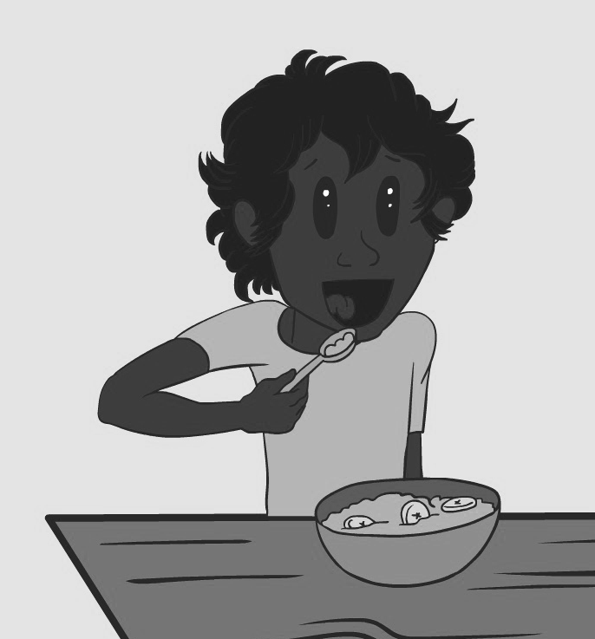
ngarni /'ŋaɳi/
'eat'
Word-initial
Word-medial
Nangala /'naŋala/
'Nangala'
/ɳ/
Acquired at 75% accuracy after age 72 months
Note: ‘Nangala’ is a Warlpiri ‘skin name’.
Note: The phoneme /ɳ/ is written ‘rn’, except word-initially, when it is written ‘n’.

Slide 19
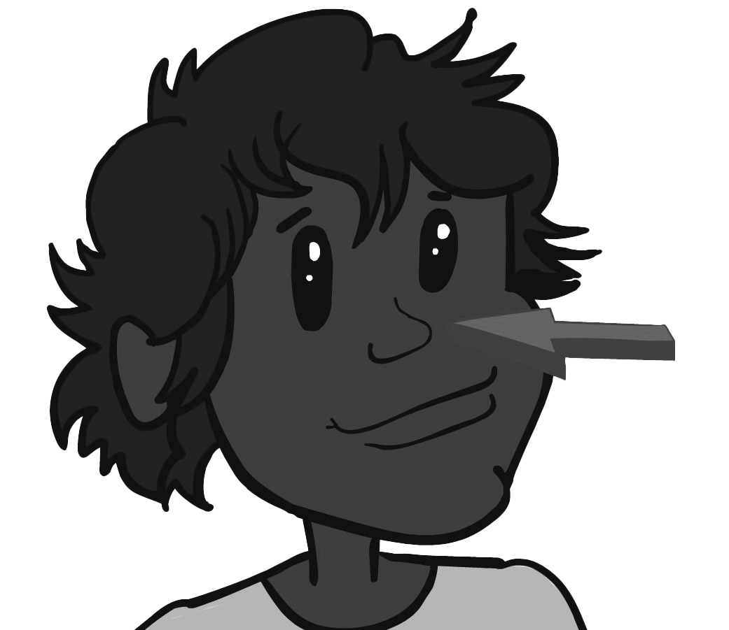
mulyu /'muʎu/
'nose'
Word-initial
Word-medial
This phoneme doesn’t occur at the beginning of words.
/ʎ/
Acquired at 75% accuracy after 72 months – not many examples in our study

Slide 20
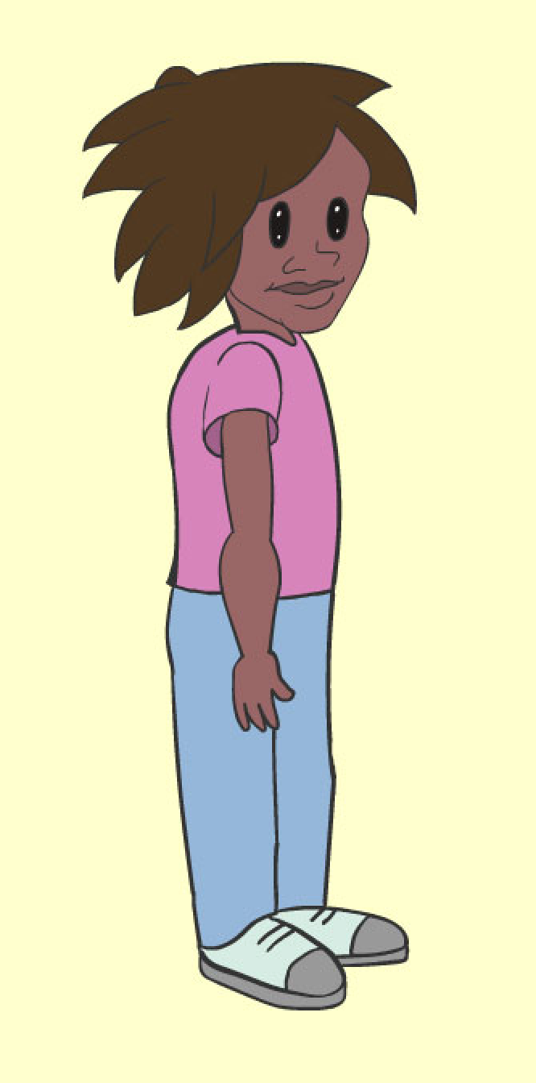
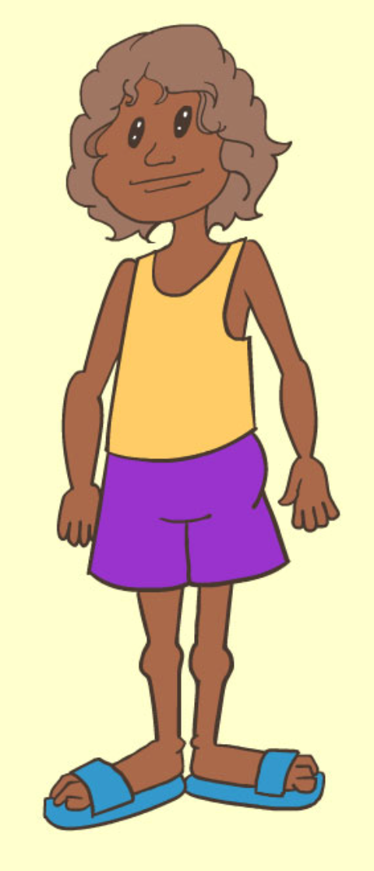
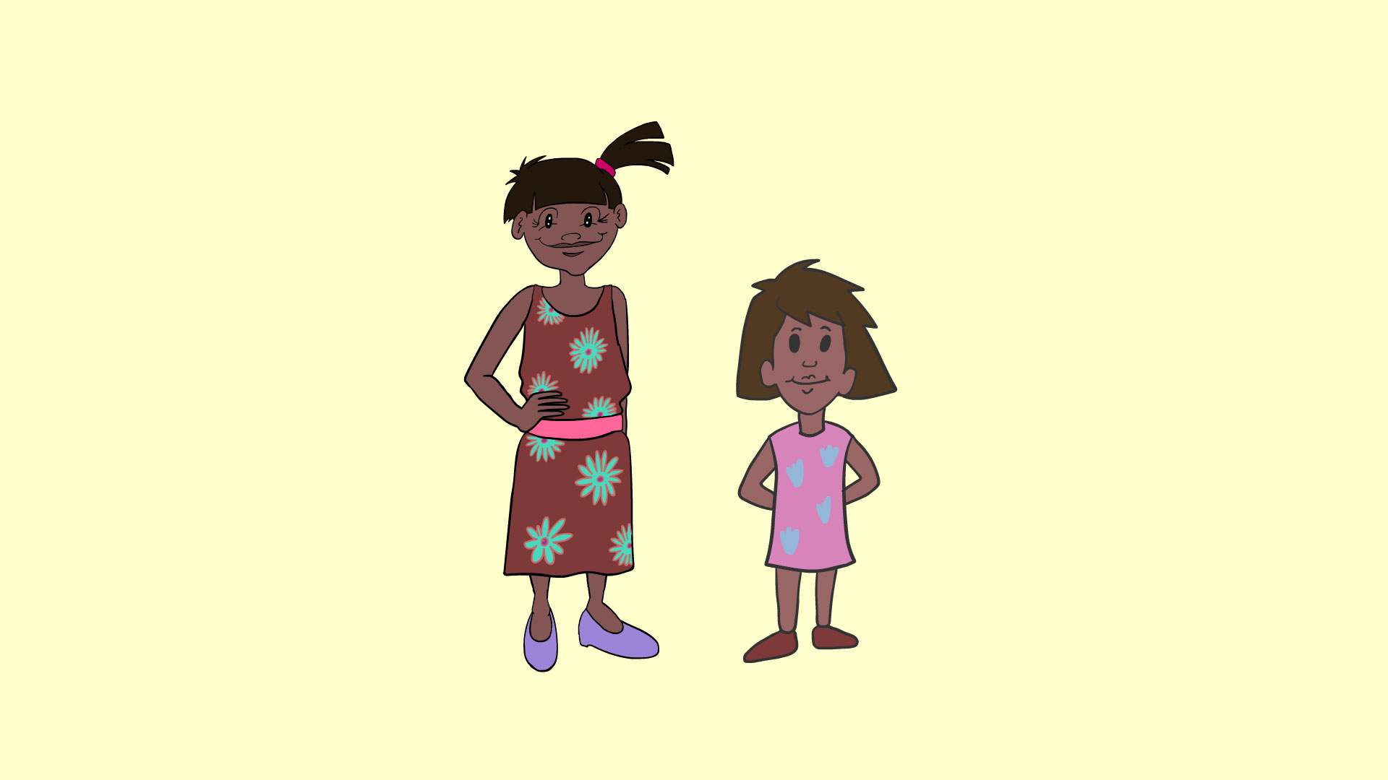
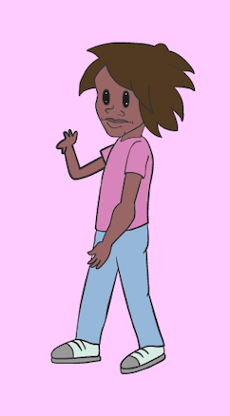
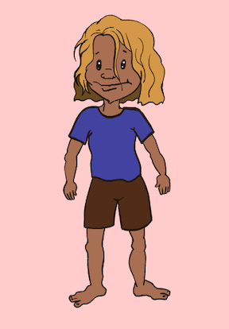
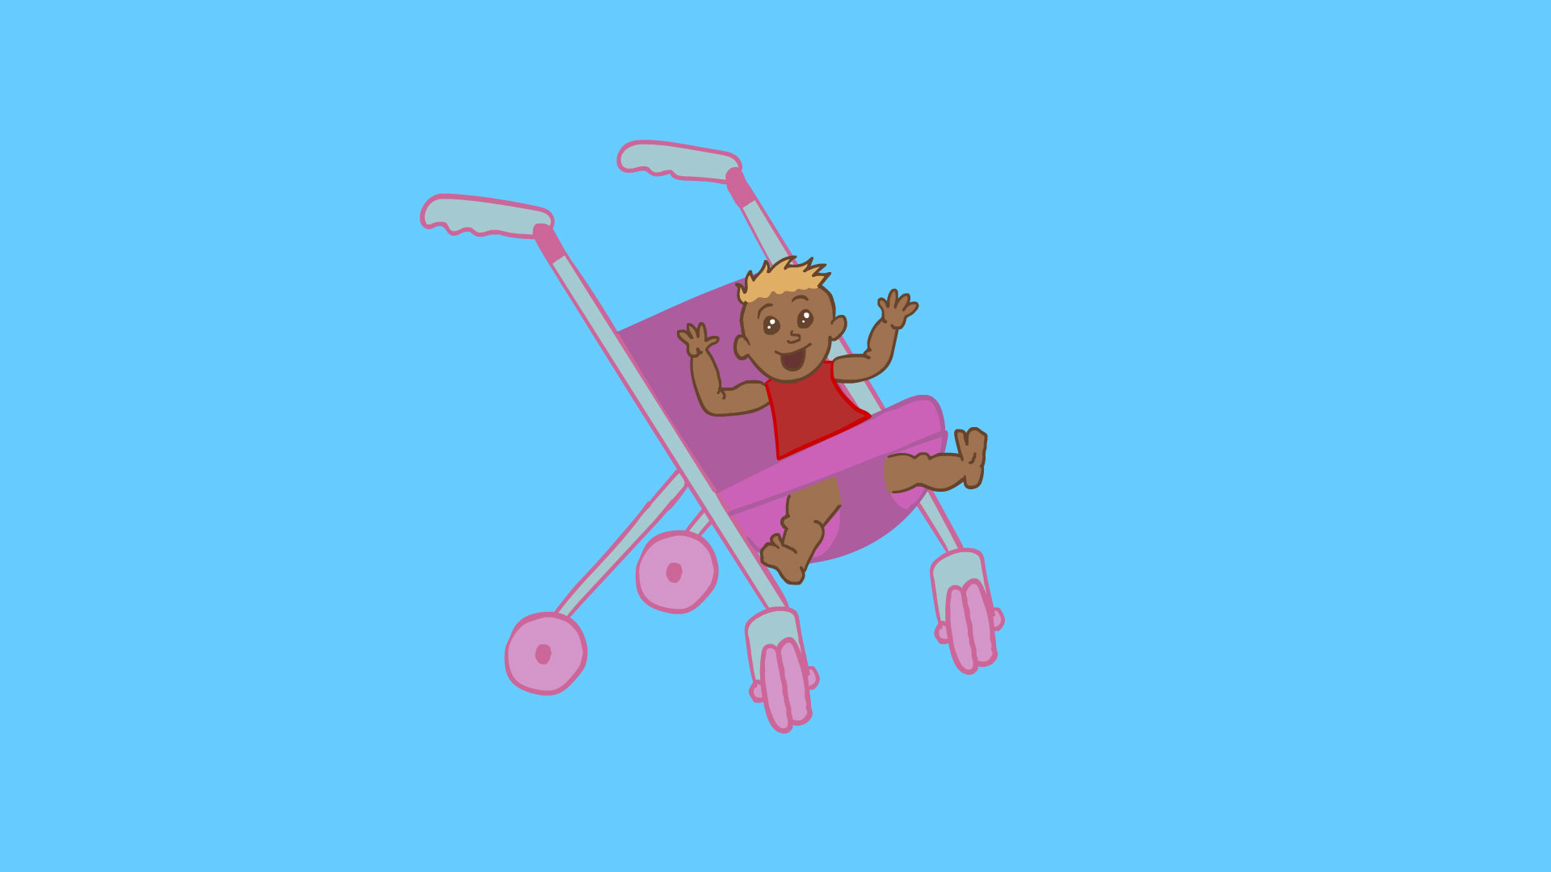
Warlpiri consonant production
75% adult-like
(work in progress)
Not enough examples; maybe after 72 mths old
/ɳ, ʎ/ /ʈ/
5-6 years old
(60-72 mths)
4-5 years old
(48-60 mths)
Spelling: rn, ly, rt
/ ɲ, ɻ, r, ɽ /
3-4 years old
(36-48 mths)
/c, ɭ/
Spelling: ny, r, rr, rd
2-3 years old
(24-36 mths)
/ŋ/
Spelling: j, rl
/p, t, l, j/
Spelling: ng
By 2 years old
(24 mths)
Spelling: p, t, l, y
/m, n, k, w/
Spelling: m, n, k, w

Slide 21
Notes
This information is from work-in-progress, not yet published.
We video-recorded 26 families (35 children ages 16 months - 5 yrs), and
  Interviewed caregivers about daily interactions – e.g. foods, activities, places
  Recorded caregivers and children talking about picture books, in free play and with some toys
  Transcribed and translated the recordings
  Listened to the sounds children produced in Warlpiri
We analysed 2,943 sounds from 27 children, including
  8 children: Little Kids Learning Languages project (O’Shannessy et. al. 2023)
  12 children: The longitudinal corpus of language acquisition, maintenance and contact: Warlpiri & Light Warlpiri (O’Shannessy 2024)
  7 children: recordings by Edith Bavin and Warlpiri researchers in 1983
Project website:
https://little-kids-learning-languages.net/
O'Shannessy, Carmel, Vanessa Davis, Jessie Bartlett, Alice Nelson, Denise Foster21, and Tangentyere Council. "Developing the Little Kids’ Word List app, a fair assessment tool of communicative development for young Aboriginal children in multilingual families in Central Australia." STUDIES IN LANGUAGE 12, no. 2 (2023): 286.
O’Shannessy, Carmel. "The longitudinal corpus of language acquisition, maintenance and contact: Warlpiri & Light Warlpiri." Australian Journal of Linguistics 44, no. 2-3 (2024): 127-145. https://doi.org/10.1080/07268602.2024.2380670

