Slide 1
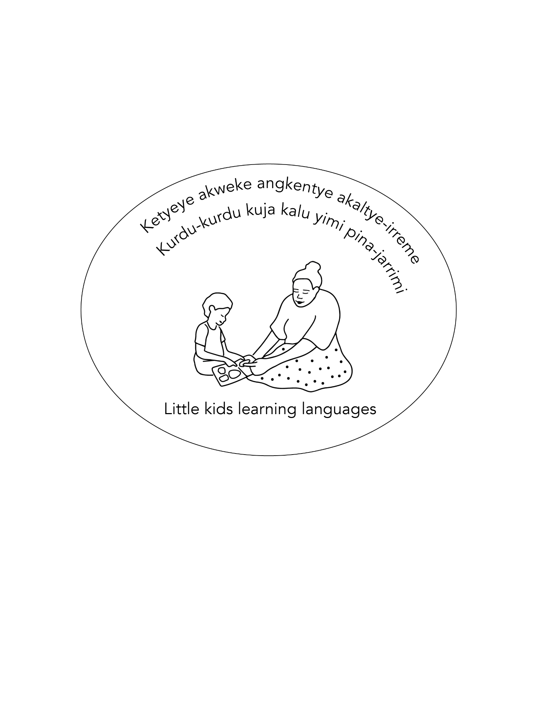

Sounds of central Australian languages
Project website:
https://little-kids-learning-languages.net/

Slide 2
Warlpiri consonant inventory & spelling
Spelling is in red and phonetic symbols are in black //
Place: where the sound is made Manner: how the sound is made | Bilabial (at the lips) | Alveolar (behind the top of the teeth) | Retroflex tongue (tongue curled back and up) | Palatal (tongue on the palate) | Velar (tongue touches the velum or back of the mouth)
Stop (complete closure) | p /p/ | t /t/ | rt /ʈ/ | j /c/ | k /c/
Nasal (air through the nose) | m /m/ | n /n/ | rn /ɳ/ | ny /ɲ/ | ng /ŋ/
Trill (fast repeated tongue movement) |  | rr /r/
Tap (fast single tongue tap) |  |  | rd /ɽ/
Semi-vowel | w /w/ |  | r /ɻ/ | y /j/
Lateral (sides of tongue) |  | l /l/ | rl /ɭ/ | ly /ʎ/
Note: Sometimes two letters represent a single sound.

Slide 3
Pitjantjatjara consonant inventory and spelling
Spelling is in red and phonetic symbols are in black //
Place: where the sound is made Manner: how the sound is made | Bilabial (at the lips) | Alveolar (behind the top of the teeth) | Retroflex tongue (tongue curled back and up) | Palatal (tongue on the palate) | Velar (tongue touches the velum or back of the mouth)
Stop (complete closure) | p /p/ | t /t/ | t /ʈ/ | tj /c/ | k /c/
Nasal (air through the nose) | m /m/ | n /n/ | n /ɳ/ | ny /ɲ/ | ng /ŋ/
Trill (fast repeated tongue movement) |  | r /r/
Tap (fast single tongue tap)
Semi-vowel | w /w/ |  | r /ɻ/ | y /j/
Lateral (sides of tongue) |  | l /l/ | l /ɭ/ | ly /ʎ/
Note: these letters are underlined in this language.

Slide 4
Pintupi-Luritja consonant inventory and spelling
Spelling is in red and phonetic symbols are in black //
Place: where the sound is made Manner: how the sound is made | Bilabial (at the lips) | Alveolar (behind the top of the teeth) | Retroflex tongue (tongue curled back and up) | Palatal (tongue on the palate) | Velar (tongue touches the velum or back of the mouth)
Stop (complete closure) | p /p/ | t /t/ | t /ʈ/ | tj /c/ | k /c/
Nasal (air through the nose) | m /m/ | n /n/ | n /ɳ/ | ny /ɲ/ | ng /ŋ/
Trill (fast repeated tongue movement) |  | rr /r/
Tap (fast single tongue tap)
Semi-vowel | w /w/ |  | r /ɻ/ | y /j/
Lateral (sides of tongue) |  | l /l/ | l /ɭ/ | ly /ʎ/
Note: these letters are underlined in this language.

Slide 5
Arrernte consonant inventory & spelling
Spelling is in red and phonetic symbols are in black //
Place: where the sound is made Manner: how the sound is made | Bilabial (at the lips) | Interdental (tongue is between the teeth or behind the bottom teeth) | Alveolar (behind the top of the teeth) | Retroflex tongue (tongue curled back and up) | Palatal (tongue on the palate) | Velar (tongue touches the velum or back of the mouth)
Stop (complete closure) | p /p/ | th /t/ | t /t/ | rt /ʈ/ | ty or tj /c/ | k /k/
Nasal (air through the nose) | m /m/ | nh /n/ | n /n/ | rn /ɳ/ | ny /ɲ/ | ng /ŋ/
Pre-stopped nasals (as top and a nasal at the same time) | pm /^{p}m/ | thn or tnh | tn /^{t}n/ | rtn /ʈn/ | tny /^{c}ɲ/ | kng /^{k}ŋ/
Trill (fast repeated tongue movement) |  |  | rr /r/
Semi-vowel | w /w/ |  |  | r /ɻ/ | y /j/ | h /ɰ/
Lateral (sides of tongue) |  | lh /l/ | l /l/ | rl /ɭ/ | ly /ʎ/
̪
̪
/^{t}n/
̪
̪
̪
IPA representations from Turpin, Myfany, Katherine Demuth, and April Ngampart Campbell. "Phonological aspects of Arandic baby talk." Language Description Informed by Theory, eds R. Pensalfini, M. Turpin, and D. Guillemin (Amsterdam: John Benjamins) (2014): 49-80. Spelling from Dobson, Veronica Perrurle & Henderson, John. Eastern & Central Arrernte to English Dictionary. Institute for Aboriginal Development Press. Alice Springs, NT. (1994/2020) and Roennfeldt, David, with members of the communities of Ntaria, Ipolera, Undarana, Red Sand Hill, Old Station and other outstations. Western Arrarnta picture dictionary. Institute for Aboriginal Development Press. (2006).

Slide 6
Traditional languages in central Australia share some sounds.
Some sounds occur in only some languages. Spelling may differ between languages or varieties.
Place/Manner | Bilabial | Interdental - Only in Arandic languages | Alveolar | Retroflex tongue | Palatal | Velar
Stop | p /p/ | th /t/ | t /t/ | rt, t /ʈ/ | j, ty, tj /c/ | k /k/
Nasal | m /m/ | nh /n/ | n /n/ | rn, n /ɳ/ | ny /ɲ/ | ng /ŋ/
Pre-stopped nasals – only in Arandic languages | pm /^{p}m/ | thn, tnh | tn /^{t}n/ | rtn /ʈn/ | tny /^{c}ɲ/ | kng /^{k}ŋ/
Trill |  |  | rr /r/
Tap |  |  | rd /ɽ/ (only in Warlpiri)
Semi-vowel | w /w/ | lh /l/ |  | r, r /ɻ/ | y /j/ | h /ɰ/ (only in Arandic)
Lateral |  |  | l /l/ | rl, l /ɭ/ | ly /ʎ/
̪
̪
/^{t}n/
̪
̪
̪
Note: the spelling is different depending on the language.

Slide 7
Sources of information
Arrernte: Dobson, Veronica Perrurle & Henderson, John. Eastern & Central Arrernte to English Dictionary. Institute for Aboriginal Development Press. Alice Springs, NT. (1994/2020).
Roennfeldt, David, with members of the communities of Ntaria, Ipolera, Undarana, Red Sand Hill, Old Station and other outstations. Western Arrarnta picture dictionary. IAD Press. Alice Springs, NT. (2006).
Turpin, Myfany, Katherine Demuth, and April Ngampart Campbell. "Phonological aspects of Arandic baby talk." Language Description Informed by Theory, eds R. Pensalfini, M. Turpin, and D. Guillemin (Amsterdam: John Benjamins) (2014): 49-80.
Breen, Gavan, and Veronica Dobson. "Central Arrernte." Journal of the International Phonetic Association 35, no. 2 (2005): 249-254.
Pitjantjatjara: Goddard, Cliff & Rebecca Defina. Pitjantjatjara/Yankunytjatjara to English Dictionary (2nd ed.). Institute for Aboriginal Development Press. Alice Springs, NT. 1992/2020.
Pintupi-Luritja: Heffernan, John A., and Kugata Heffernan. A learner's guide to Pintupi-Luritja. Institute for Aboriginal Development Press. Alice Springs, NT. 2000.
Warlpiri: Laughren, Mary, Kenneth Hale, Jeannie Egan Nungarrayi, Marlurrku Paddy Patrick Jangala, Robert Hoogenraad, David Nash, and Jane Simpson. Warlpiri encyclopaedic dictionary. (2022). Aboriginal Studies Press.
https://shop.aiatsis.gov.au/products/warlpiri-encyclopaedic-dictionary
International Phonetic Association https://www.internationalphoneticassociation.org/
Warlpiri sound recordings are from the Little Kids Learning Languages project

